Slide 1
Rise of the British
With the crumbling of Mughal Empire, the new rising power in the subcontinent was the British through the British East India Company
1600 AD: After an unsuccessful attempt to establish trade with Indonesia, the East India Company turned to India
1608 AD: The first British ship harboured at Surat. Permission to land denied.
1612 AD: Shahjahan, still a prince, granted permission for trade to British East India Company.

Slide 2
1674 AD: East India Company Moved its Headquarter to Bombay (Now Mumbai).
1690 AD: Founded the town of Culcutta.
1740 AD: Ten percent of all revenues of Britain came from India.
1751 AD: Britain defeated the French in India and held trade monopoly in subcontinent.
1757 AD: British defeated the Nawab of Bengal at Plassy. Bengal was the richest province of Mughal Empire.

Slide 3
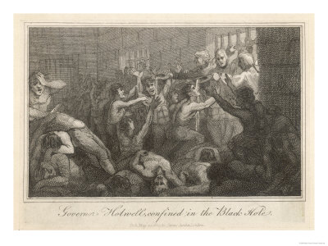
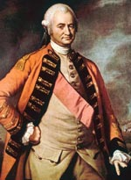
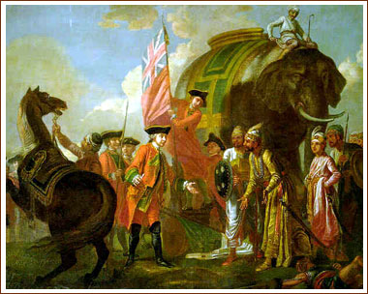

Slide 4
The British Raj
1764 AD: The Battle of Buxar brought the Nawab of Oudh under British control.
The British were now strong enough to make laws in India.
1784 AD: The India Act was passed by the British Parliament. They could now appoint a Governor General, Provincial Governors and Commander-in-Chief.
1786 AD: Lord Cornwallis was appointed the First Commander-in-Chief.

Slide 5
British form of Government set up: New Police and Civil Administration barring all locals.
New legal system established along British lines.
1799 AD: Tepu sultan was defeated at Mysore and his territory seized by the British.
1803 AD: British Troops entered Delhi.
1833 AD: Government of India Act (East India Company was holding its possessions in Trust for the British Government).

Slide 6
1834 AD: English replaced Persian as the official Administrative Language
1835 AD: The “Minutes of Macaulay”: the education would now be in English

Slide 7
Further Consolidations
A Treaty was signed with Ranjit Singh in Punjab in 1809.
For fear of other foreign invasions of India, the British tried to consolidate their rule in Punjab and Afghanistan.
Afghanistan could not be conquered. After two attempts in 1841, British withdrew from Afghanistan.
1843 AD: The British conquered Sindh.

Slide 8
1846 AD: After several battles with Sikh armies British entered Lahore. After the death of Ranjit Singh in 1839, Punjab had weakened considerably.
1846 AD: Kashmir was detached from Punjab and sold to Hindu Dogra, Raja Gulab Singh.
1849 AD: Punjab was annexed to British territories.

Slide 9
Distant causes of revolt
Industrial Revolution in Britain
Need for raw materials and foreign markets
Discouraged local Indian industries and limited Indian imports to Britain
1857 AD: British Army now comprised of 128,000 local and 23,000 British.(?)
Disparity between the two caused unrest.
Fear that both Hinduism and Islam are under threat from Christianity.
Change of language in 1835 from Persian and Sanskrit to English seen with disfavour.

Slide 10
Social reforms introduced without keeping in mind local practices and sentiments. (Female infanticide 1795, Suttee 1829, Religious Disabilities Act 1856)
Introduction of Doctrine of Lapse in 1852.
General Service Enlistment Act of 1856 (New recruits were required to serve anywhere in India or overseas).

Slide 11
Immediate Cause
The immediate cause of the revolt was introduction of new rifle cartridges which was coated with cow and pig fat. This caused an uproar among both the Hindu and Muslim soldiers
In Meerut the sepoys killed their British officers and gave impetus to other uprisings.

Slide 12
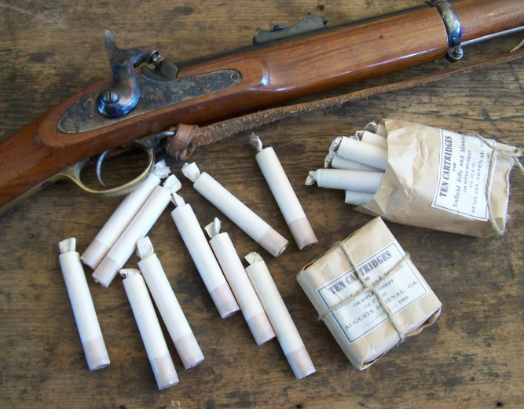
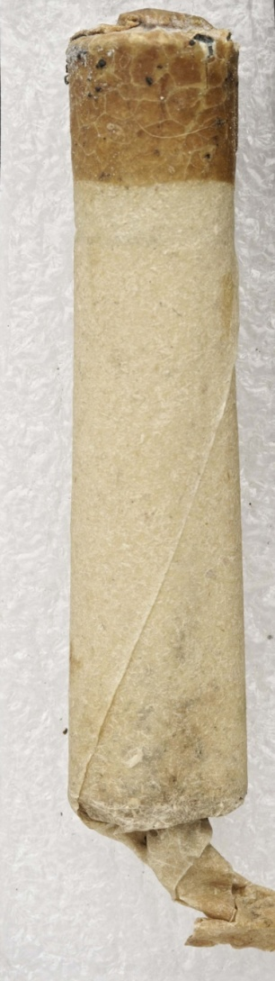
Enfield Rifle

Slide 13
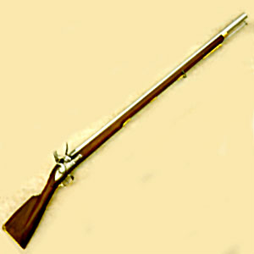
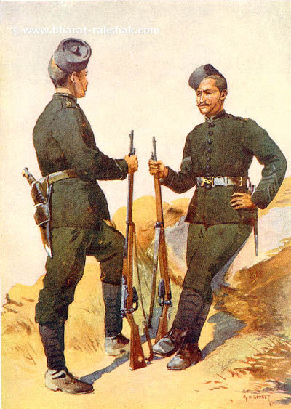
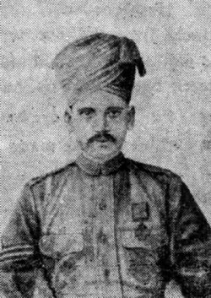

Slide 14
Sepoys marched towards Delhi and captured it. Bahadur Shah II was forced to lead the campaign.
Rani of Jhansi fought valiantly in the war of 1857 and captured Gawaliar from the British but was killed when British recaptured it.
Nana Saheb, adopted son of Peshwa of Marhatas revolted to get his State back.

Slide 15
Causes of Failure
Lack of unity among local population.
The revolting chieftain had their personal objectives.
Some Indian Chieftain sided with the British.
The British played one community against the other.
The British had modern equipment and adequate supply of arms and more disciplined force.

Slide 16
No national spirit: it was seen as a Muslim rebellion to get the Mughals back on the throne.
Hindus and Sikhs were not keen to lend their support.
Dogra Raja of Kashmir provided 2000 troops to crush the rebellion.

Slide 17
Outcome of War of Independence
The British after1857 took full control.
They kept political and Military control in their own hands and did not depend on local Chiefs and Rulers.
The British saw the Muslims as the main instigator of the rebellion.
All Jagirs, holdings and titles of Muslims were confiscated.

Slide 18
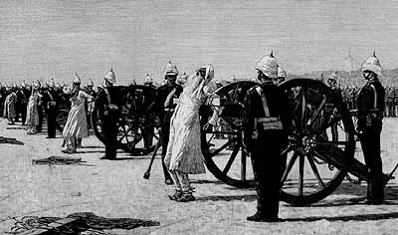

Slide 19
A large number of notable Muslims were hanged or blown through cannons in suspicion of their involvement in the rebellion.
Doors for jobs were shut on Muslims.
The British Government through an Act of Parliament took over the control of India from East India Company in 1858.
The Queen was officially declared Empress of India in 1877

Slide 20
Thank You

